Slide 1
Understanding Myeloproliferative
Neoplasms (MPNs)
Polycythemia Vera, Essential Thrombocythemia, and Myelofibrosis

Slide 2
Purpose of These Slides
These slides will
Provide patient-level information on the 3 main types of Philadelphia chromosome-negative MPNs
Provide information regarding how these MPNs
may progress and affect patients
Provide information to patients and caregivers on ways to take care of themselves
Provide an overview of some resources on MPNs that are available to the MPN community
These slides will not
Provide a comprehensive, in-depth overview of MPNs
Provide any specific clinical or medical advice—all patients should consult their physicians or other qualified health provider with any questions they may have about their medical condition.
v
These slides are being made available for the MPN community to help educate patients.*
*This presentation is for information purposes only and is provided on an “as is” basis.

Slide 3
Information Provided in These Slides
Overview of Myeloproliferative Neoplasms (MPNs)
Origins of MPNs
Genetics of MPNs
Common Features
Common Laboratory Testing
Understanding the 3 Main Types of Philadelphia Chromosome-Negative MPNs
  - Polycythemia Vera
  - Essential Thrombocythemia
  - Myelofibrosis
Take an Active Role in Managing Your Condition
Steps to Be Your Own Advocate

Slide 4
Myeloproliferative Neoplasms (MPNs)
A Group of Rare Blood Disorders

Slide 5
The Different MPNs
MPNs
Philadelphia
chromosome-positive¹
MPNs
Philadelphia chromosome-negative¹
Chronic Myeloid
Leukemia (CML)
Polycythemia
Vera (PV)
Essential Thrombocythemia (ET)
Myelofibrosis (MF)
(Primary MF)
Other rare*
~10%
MF transformation rate
per 10 years²
~4%
Post-PV MF
(Secondary MF)
Post-ET MF
(Secondary MF)
Risk of progression to acute myelogenous leukemia
*Other rare Philadelphia chromosome-negative MPNs include Chronic Neutrophilic Leukemia,
Mastocytosis, and Chronic Eosinophilic Leukemia.³
1. NORD Physician Guide. Myeloproliferative Neoplasms. NORD web site. http://nordphysicianguides.org/myelofibrosis/what-is-myelofibrosis/. Accessed September 29, 2015. 2. Tefferi A. Am J Hematol. 2008; 83(6):491-497. 3. Thiele J. Am J Clin Pathol. 2009;132:261-280.

Slide 6
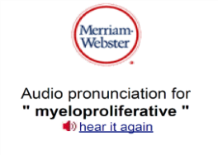
Understanding the Name: MPN
Myeloproliferative¹
Neoplasm²
Pronunciation: my·e·lo·pro·lif·er·a·tive
myelos—Greek word meaning
bone marrow
proliferative—Greek word meaning growing or reproducing rapidly
Pronunciation: neo·plasm
  neo—Greek word meaning new
  plasm—Greek word meaning formation
Definition:
Increased growth of blood cells in the bone marrow
Definition:
Out-of-control growth of cells serving
no physiological function
neoplasm = abnormal growth of cells
cancer = abnormal growth of cells
To find patient-friendly medical
definitions online, look for
MedlinePlus Dictionary.
1. MedlinePlus Merriam Webster Medical Dictionary. Neoplasm. MedlinePlus web site. http://www.merriam-webster.com/medlineplus/neoplasm. Accessed March 11, 2015. 2. MedlinePlus Merriam Webster Medical Dictionary. Myeloproliferative. MedlinePlus web site. http://www.merriam-webster.com/medlineplus/myeloproliferative. Accessed March 11, 2015. 3. Seattle Cancer Care Alliance. MPN Facts. http://www.seattlecca.org/diseases/myeloproliferative-neoplasms-facts.cfm. Accessed March 11, 2015.

Slide 7
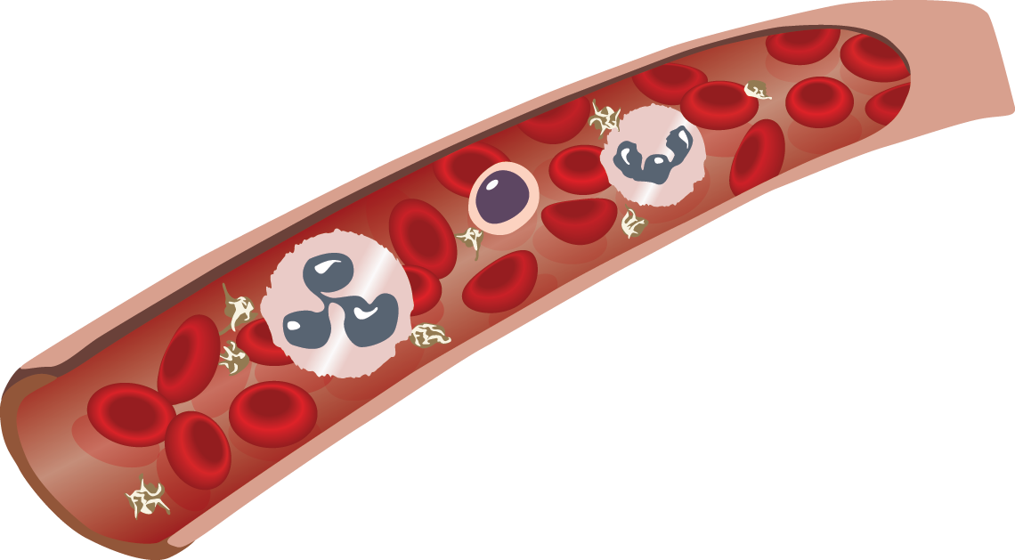
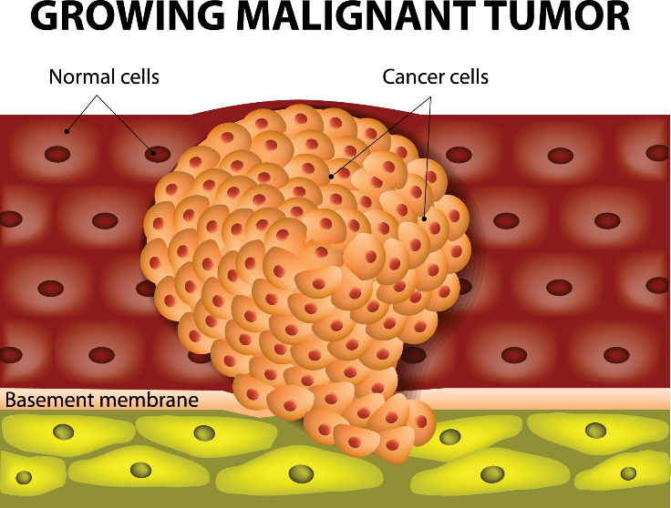
MPNs Are “Liquid” Tumors
We call tumors “liquid” or “solid” based on where they grow in the body¹
“Liquid” tumors are cancers present in body fluids like blood and bone marrow that can travel to other parts of the body²
“Solid” tumors are a mass of cells that may be cancerous (malignant) or noncancerous (benign)³
1. Chaddah M. Cancers: Solid Tumors. Stem Cell Network. http://oirm.ca/sites/default/files/disease-cancer-solid_tumour.pdf. Published June 2013. Accessed December 23, 2015. 2. Cleveland Clinic. What is cancer? https://my.clevelandclinic.org/services/cancer/wellness-prevention/what-is-cancer. Accessed December 21, 2015. 3. Medical News Today. Tumors: Benign, Premalignant and Malignant. http://www.medicalnewstoday.com/articles/249141.php. Accessed December 21, 2015.

Slide 8
Philadelphia Chromosome-Negative MPNs
Are Rare
Essential Thrombocythemia (ET): About 71,000 people in the US²
Myelofibrosis (MF):
About 16,000 to
18,500 people
in the US³
Polycythemia Vera (PV):
About 100,000 people in
the US¹
1. Stuart BJ, Viera AJ. Am Fam Physician. 2004;69:2139-2144. 2. Ma X, Vanasse G, Cartnel B, et al. Am J Hematology. 2008;83(5):359-62. 3. Komrokji RS, Verstovsek S, Padron E, et al. Cancer Control. 2012:19(4):4-15.

Slide 9
Landmark Health Survey—
Impact of MPNs on Patients’ Lives
2014 MPN Landmark Health Survey conducted by expert panel found that
91% MF
79% MF
21%
MF
Most patients reported feeling anxious or worried about their MPN:
Interference with family or social life reported by patients:
Patients reported cancelling planned activities 1 to 3 days over a 30-day period:
78% PV
63% PV
18%
PV
74% ET
55% ET
18%
ET
Mesa R, Miller C, Thyne M, et al. BMC Cancer. 2016;16:167.

Slide 10
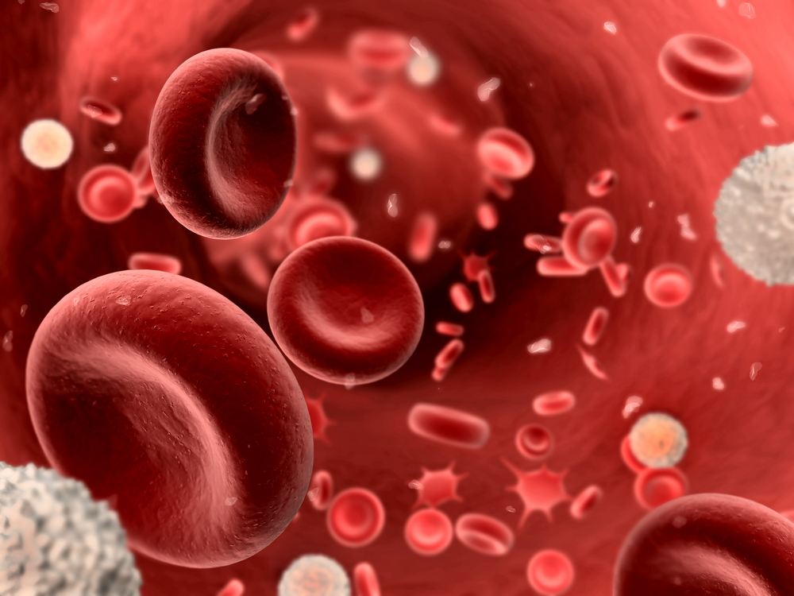
The Origin of MPNs

Slide 11
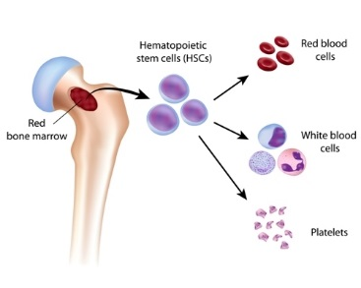
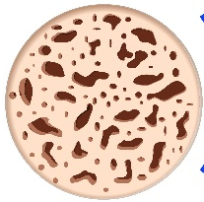
Blood Cells Develop in the Bone Marrow
Red blood
cells (erythrocytes)
White blood
cells (leukocytes)
Blood stem cells are located in bone marrow
Platelets
The website of the National Cancer Institute (http://www.cancer.gov).
The cells created by your bone marrow need to be replaced every few days, weeks, or months.
National Cancer Institute. Chronic Myeloproliferative Neoplasms Treatment (PDQ®) Patient Version. National Cancer Institute web site. http://www.cancer.gov/cancertopics/pdq/treatment/myeloproliferative/Patient. Updated November 11, 2014. Accessed March 11, 2015.

Slide 12
In MPNs, Blood Stem Cells Function Abnormally
Red blood
cells (erythrocytes)
White blood
cells (leukocytes)
Blood stem cells are located in bone marrow
Platelets
The website of the National Cancer Institute (http://www.cancer.gov).
Changes to blood stem cells lead to
  Overproduction of one or more blood cell types
  Improper overall balance in production of blood cell types
MPN Education Foundation. MPNs. MPN Education Foundation web site. http://mpdinfo.org/mpns. Accessed March 11, 2015.

Slide 13
The Genetics of MPNs

Slide 14
Mutations Are More Common As We Age
A gene mutation is a permanent alteration in the DNA sequence¹
  Hereditary
  Acquired/Somatic
The longer we live, the more
exposure we have to things that can cause somatic mutations²
Mutations are not common in patients 40 and under, but the likelihood increases significantly after the
age of 60³
Frequency
20-29
30-39
40-49
50-59
60-69
70-79
80-89
90-99
100-108
From Jaiswal S, Fontanillas P, Flannick J, et al. Age-related clonal hematopoiesis associated with adverse outcomes. N Engl J Med. 2014;371:2488-2498. Copyright © 2014 Massachusetts Medical Society. Reprinted with permission from Massachusetts Medical Society.
1. National Institute of Health. What is a gene mutation and how do mutations occur? http://ghr.nlm.nih.gov/handbook/mutationsanddisorders/genemutation. Updated January 4, 2016. Accessed January 5, 2016. 2. Park I. MiSciWriters. The Relationship Between Cancer and Aging: Why It is Relevant. http://misciwriters.com/2015/09/29/the-relationship-between-cancer-and-aging-why-it-is-relevant. Accessed December 23, 2015. 3. Jaiswal S, et al. N Engl J Med. 2014;371:2488-2498.

Slide 15

Genetic Mutations Associated With MPNs
Genetic mutations associated with MPNs affect the way cells communicate, also known as cell signaling¹
Genetic mutations cause the JAK pathway to become overactive leading to¹
  Overproduction of blood cells
  Disease-related signs
All people with one of the 3 main Philadelphia chromosome-negative MPNs have an overactive JAK pathway¹
Mutated genes include^{2,3}
  JAK2 (janus kinase 2)
  MPL (thrombopoietin receptor)
  CALR (calreticulin)
1. Vainchenker W, Delhommeau F, Constantinescu SN, Bernard OA. Blood. 2011;118:1723-1735. 2. Tefferi A. Am J Hematol. 2008; 83(6):491-497. 3. MPN Research Foundation. Learning about MPNs – PV, ET, PMF. MPN Research Foundation web site. http://www.mpnresearchfoundation.org/. Accessed March 11, 2015.

Slide 16
Common Acquired Mutations With MPNs
Almost every PV patient (97%) will have the JAK2V617F mutation, whereas it is present in 50% of ET and PMF patients
The MPL mutation is present in 4% to10% of ET and PMF patients
The CALR mutation is found in 73% of MPN patients without the JAK2V617F or MPL mutation
Nangalia J, Massie CE, Baxter EJ, et al. N Engl J Med. 2013;369:2391-2405.

Slide 17
Other Mutations Linked to MPNs
Number of MPN Patients With Mutation
Some patients with PV may be more likely to have the TET2 and JAK2 exon 12 mutations
Small numbers of PMF patients may have ASXL1 and EZH2 mutations present
ET patients may also have DNMT3A and TET2 mutations
Republished with permission of American Society of Hematology, from Lundberg P, Karow A, Nienhold R, et al. Clonal evolution and clinical correlates of somatic mutations in myeloproliferative neoplasms. Blood. 2014;123(14):2220–2228; permission conveyed through Copyright Clearance Center, Inc.
Lundberg P, Karow A, Nienhold R, et al. Blood. 2014; 123(14):2220-2228.

Slide 18
Common Features of MPNs

Slide 19
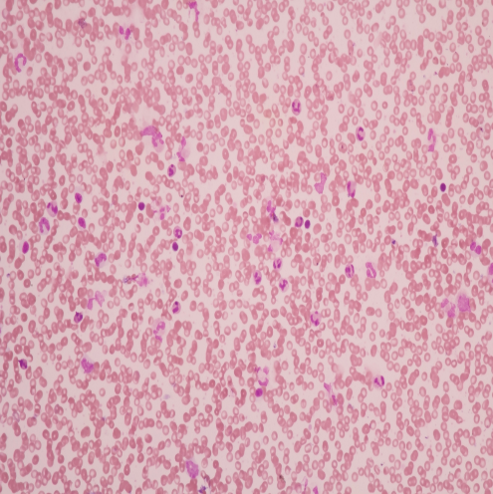
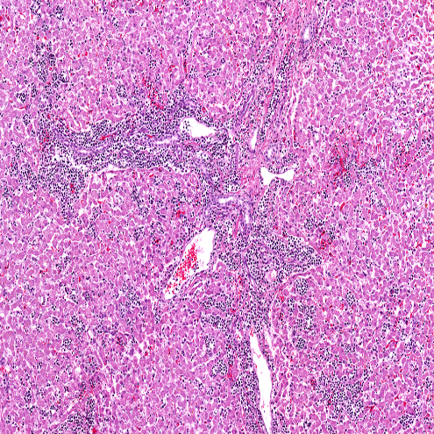
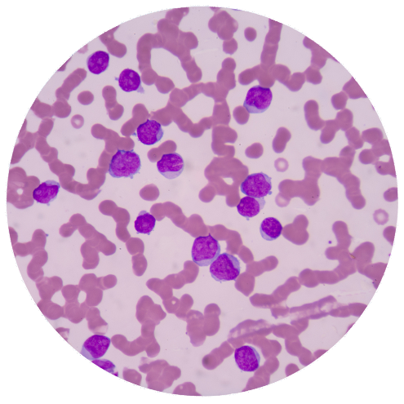
Disease Progression in MPN
The 3 phases of MPN:
- Chronic, the early phase
- Accelerated, disease progression
- Leukemic, in which MPN transforms into leukemia
As MPN progresses through the phases, patients are more likely to have a higher number of chromosomal abnormalities
Chronic
Accelerated
Leukemic
Republished with permission of American Society of Hematology, from Tefferi A, Guglielmelli, Larson DR, et al. Long-term survival and blast transformation in molecularly annotated essential thrombocythemia, polycythemia vera, and myelofibrosis. Blood. 2014;124(16):2507-2513; permission conveyed through Copyright Clearance Center, Inc.
Klampfl T, Harutyunyan A, Berg T, et al. Blood. 2011;118(1):167-176.

Slide 20
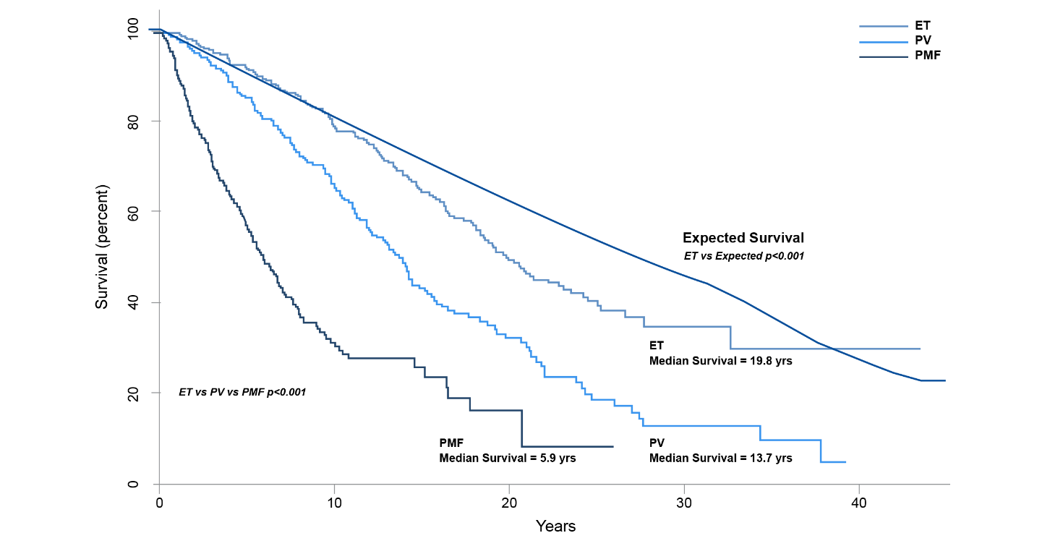
Median Expected Survival Rates in MPNs
Patients with Primary Myelofibrosis (PMF) have a median expected survival of 5.9 years
Patients with Polycythemia Vera (PV) have a median expected survival of 13.7 years
Patients with Essential Thrombocythemia (ET) have
a median expected survival of
19.8 years
Republished with permission of American Society of Hematology, from Tefferi A, Guglielmelli P, Larson DR, et al. Long-term survival and blast transformation in molecularly annotated essential thrombocythemia, polycythemia vera, and myelofibrosis. Blood. 2014;124(16):2507-2513; permission conveyed through Copyright Clearance Center, Inc.
Tefferi A, et al. Blood. 2014;124(16):2507-2513.

Slide 21

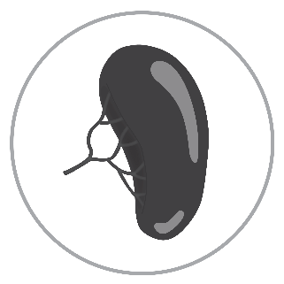

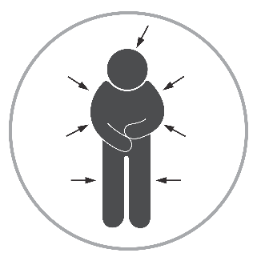
Shared Characteristics Among MPNs¹⁻³
Signs observed by your healthcare team
Abnormal blood cell production
Enlarged spleen
Bleeding/Thrombosis and other serious health complications
Symptoms that you may observe
Fatigue, night sweats, itching, and other symptoms
1. Leukemia & Lymphoma Society. Essential Thrombocythemia Facts. Leukemia & Lymphoma Society web site. http://www.lls.org/content/nationalcontent/resourcecenter/freeeducationmaterials/mpd/pdf/essentialprimarythrombocythemia.pdf. Revised June 2012. Accessed March 11, 2015. 2. Leukemia & Lymphoma Society. Myelofibrosis Facts. Leukemia & Lymphoma Society web site. http://www.lls.org/content/nationalcontent/resourcecenter/freeeducationmaterials/mpd/pdf/idiopathicmyelofibrosis.pdf. Revised April 2012. Accessed March 11, 2015. 3. Leukemia & Lymphoma Society. Polycythemia Vera Facts. Leukemia & Lymphoma Society website. http://www.lls.org/content/nationalcontent/resourcecenter/freeeducationmaterials/mpd/pdf/polycythemiavera.pdf. Revised June 2012. Accessed March 11, 2015.

Slide 22
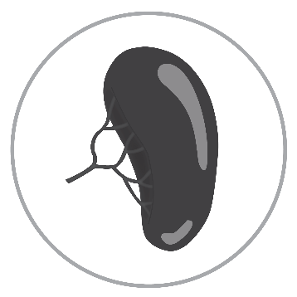
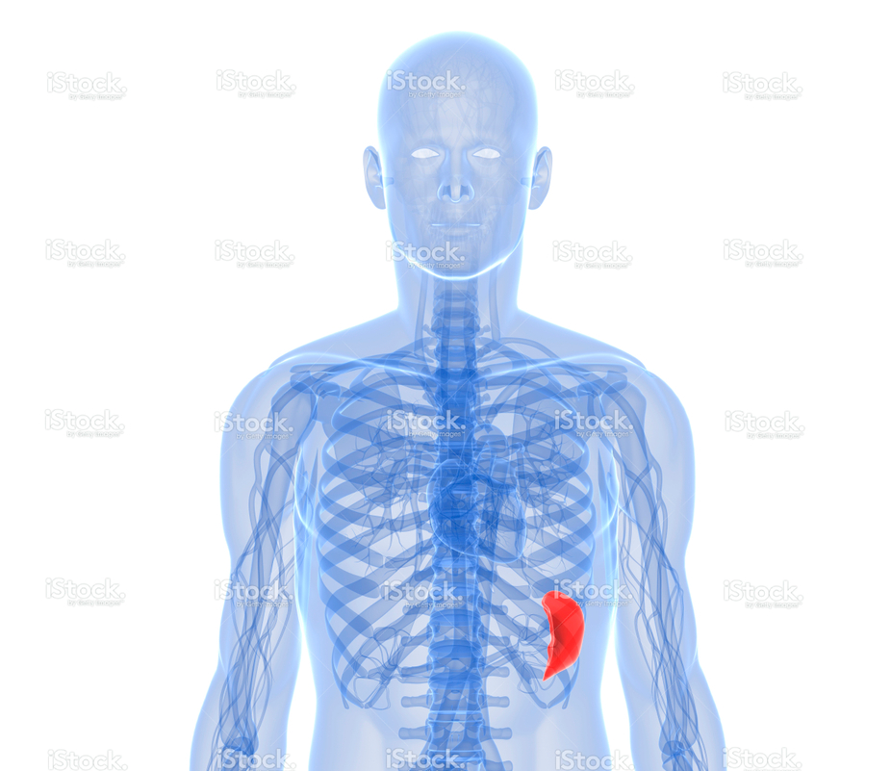
Common Signs—Enlarged Spleen in MPNs
Description
Possible consequences
The spleen becomes enlarged (splenomegaly) as it overworks, compensating for abnormal blood cell production¹
Pain or discomfort in the upper abdomen
Feeling full (early satiety)
What happens
Takes up more room in the abdomen, presses against other organs¹
Sign: something your doctor observes and is caused by your specific condition.²
The website of the National Cancer Institute (http://www.cancer.gov).
1. National Cancer Institute. Chronic Myeloproliferative Neoplasms Treatment (PDQ®) Patient Version. National Cancer Institute web site. http://www.cancer.gov/cancertopics/pdq/treatment/myeloproliferative/Patient. Updated November 11, 2014. Accessed March 11, 2015. 2. Difference Between Signs and Symptoms. http://www.differencebetween.net/science/health/difference-between-signs-and-symptoms. Updated October 6, 2009. Accessed September 30, 2015.

Slide 23
Thrombosis in MPNs
Thrombosis: formation of a blood clot within a blood vessel that obstructs the flow of blood^{1,2}
Deep vein thrombosis (DVT)
Pulmonary embolism (PE)
Portal vein thrombosis (PVT)
Heart attack
Ischemic stroke
Peripheral vascular disease (PVD) or peripheral artery disease (PAD)
1. Falanga A, Marchetti M. Semin Thromb Hemost. 2014;40(30):348-358. 2. American Society of Hematology. Blood Clots. http://www.hematology.org/Patients/Clots/. Accessed September 30, 2015.

Slide 24
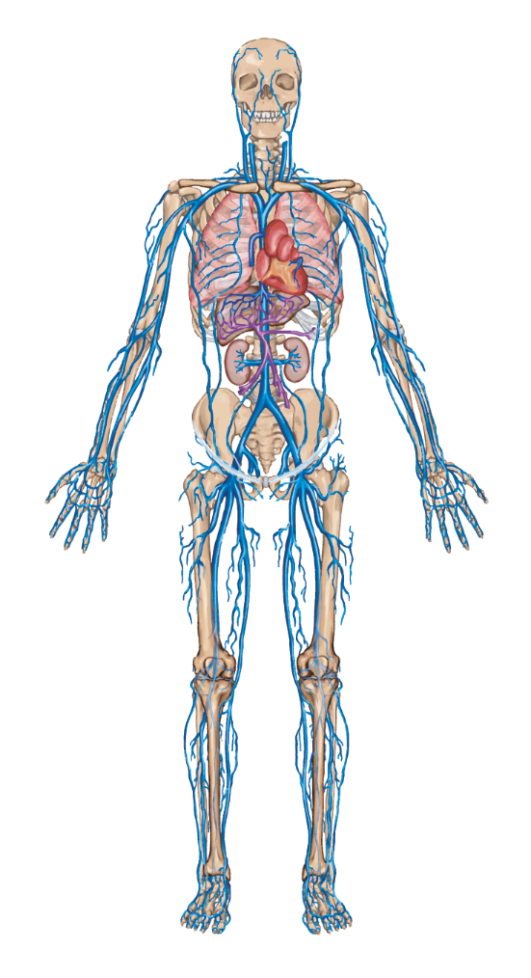
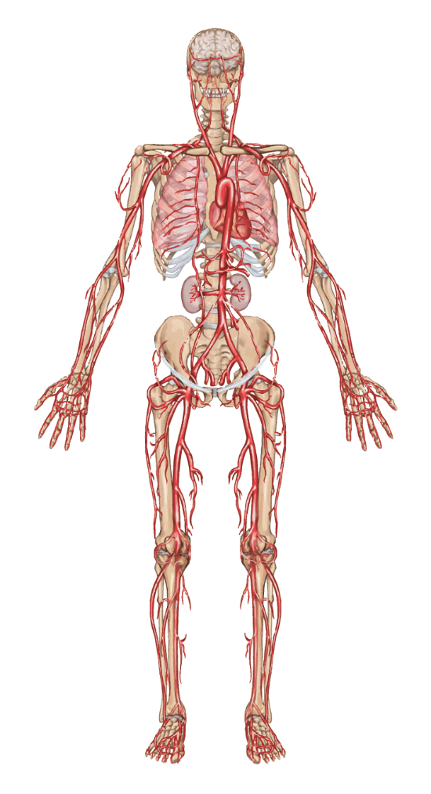
Thrombosis in the Veins and Arteries
Venous System
Arterial System
In the venous system (veins), thrombosis is more common in the lungs (pulmonary embolism or PE) or legs (deep venous thrombosis or DVT)^{1,2}
In the arterial system, thrombosis can appear as a stroke^{1,2}
Microvascular clots are blood clots that occur in the tiniest blood vessels of the body
1. Cleveland Clinic. How Does Blood Travel Through the Body. https://my.clevelandclinic.org/services/heart/heart-blood-vessels/how-does-blood-travel-through-body. Accessed December 21, 2015. 2. Falanga A, Marchetti M. Hematology Am Soc Hematol Educ Program. 2012;2012:571-581.

Slide 25
Common Laboratory Testing for Patients With MPNs

Slide 26
Common Signs—
Understanding Complete Blood Count Test
Type of Test
Information Obtained
How
Administered
Commonly
Required in
Complete blood count (CBC) with differential
Measures proportion of different types of blood cells—a CBC with differential can help measure the proportion of the different types of white blood cells and the proportion of blast cells
Sample drawn
from vein
PV, ET, and MF
1. MedlinePlus Merriam Webster Medical Dictionary. Blood Differential. MedlinePlus web site. https://www.nlm.nih.gov/medlineplus/ency/article/003657.htm. Accessed April 16, 2015. 2. MedlinePlus Merriam Webster Medical Dictionary. CBC Blood Test. MedlinePlus web site. https://www.nlm.nih.gov/medlineplus/ency/article/003642.htm. Accessed April 16, 2015.

Slide 27
Common Signs—
Understanding CBC Values
Measured CBC Values
Normal Value*
(Women)
Normal Value*
(Men)
Total Red Blood Cell Count (RBC) | 3.90-5.03 million/µL | 4.32-5.72 million/µL
Hemoglobin (Hgb)¹ | 12.0-15.5 g/dL | 13.5-17.5 g/dL
Hematocrit (Hct)¹ | 34.9%-44.5% | 38.8%-50.0%
Total white blood cell count (WBC)¹ Neutrophils² Eosinophils² Monocytes² Lymphocytes² | 3.5-10.5 billion/L 2-8 billion/L 0.1-0.4 billion/L 0.2-0.8 billion/L 1-4 billion/L | 3.5-10.5 billion/L 2-8 billion/L 0.1-0.4 billion/L 0.2-0.8 billion/L 1-4 billion/L
Platelet Count¹ | 150-450 billion/L | 150-450 billion/L
µL = microliter L = liter dL = deciliter g = grams
million = x 10⁶ billion = x 10⁹
*Lab value ranges may differ, depending on laboratory utilized, always consult with your physician regarding your specific lab values.
1. Mayo Clinic. Complete Blood Count (CBC). www.mayoclinic.org/tests-procedures/complete-blood-count/basics/results/prc-20014088. Accessed December 29, 2015. 2. Clinical Gate. Introduction to
haematology and transfusion science. http://clinicalgate.com/26‐introduction‐to‐haematology‐and‐transfusion‐science/. Accessed June 30, 2016.

Slide 28
Common Signs—
Additional Lab Tests in MPNs
Type of Test
Information Obtained
How
Administered
Commonly
Required in
Comprehensive Metabolic Panel (CMP)¹
Measures sugar (glucose) level, electrolyte and fluid balances, kidney and liver function
Sample drawn
from vein
PV, ET, and MF
Bone Marrow Aspiration and Biopsy²
Overgrowth of cells and fibrosis within the
bone marrow
Sample collected most often from the hip bone
MF (PV and ET)
Mutation Tests²
Detects specific changes in genes (mutations) that control a normal cell
Sample drawn from vein or bone marrow
PV, ET, and MF
Erythropoietin³
Measures hormones that stimulate bone marrow and production of red blood cells
Sample drawn
from vein
PV
1. MedlinePlus Merriam Webster Medical Dictionary. Comprehensive Metabolic Panel. MedlinePlus web site. https://www.nlm.nih.gov/medlineplus/ency/article/003468.htm. Accessed April 16, 2015. 2. MedlinePlus Merriam Webster Medical Dictionary. Erythropoietin Test. MedlinePlus web site. https://www.nlm.nih.gov/medlineplus/ency/article/003468.htm. Accessed April 16, 2015. 3. National Cancer Institute. Chronic Myeloproliferative Neoplasms Treatment (PDQ®) Patient Version. National Cancer Institute web site. http://www.cancer.gov/cancertopics/pdq/treatment/myeloproliferative/Patient. Updated November 11, 2014. Accessed March 11, 2015.

Slide 29
Questions You Should Ask About Lab Testing
How do I prepare for my lab tests?
How long does it take to get the results, and how do I get them?
Why can’t a really small needle be used?
Can a finger stick be used instead of a needle?
How much fluid must I drink or take in to stay properly hydrated?
v
HELPFUL HINTS
Discuss any questions or concerns you may have with your doctor
The time of day the testing is performed can have a significant impact on the results, so try to be consistent
If you take medicines that affect blood clotting, you may be advised to stop taking these or to reduce the dose for 1 week before the test
Leclair S. Common Lab Questions. MPN Education Foundation. http://mpninfo.org/data/media/2015/02/09-leclair-common-mpn-laboratory-questions.pdf. Accessed December 21, 2015.

Slide 30
Understanding the 3 Main Types of Philadelphia Chromosome-Negative
Myeloproliferative Neoplasms
Polycythemia Vera, Essential Thrombocythemia, and Myelofibrosis

Slide 31

Know Your Condition—Polycythemia Vera (PV)
Description
Possible consequences
In PV, the body makes too many red blood cells. Individuals may also have too many white blood cells or platelets¹
Patient Characteristics:
Average age of diagnosis = 60
Slightly more common in males than in females
Blood clots leading to complications such as stroke, heart attack, chest pains¹
What happens
Too many red blood cells can cause blood to thicken, making it more difficult to flow through the body²
Thicker blood flows abnormally; many organs may not get enough oxygen²
Polycythemia—POL-e-si-THEE-me-ah
  Vera—VAY-rah or VE-rah
1. Mayo Clinic. Disease and Conditions: Polycythemia Vera. http://www.mayoclinic.com/health/polycythemia-vera/DS00919. Mayo Clinic web site. Accessed April 16, 2015. 2. National Organization for Rare Disorders. Polycythemia Vera. National Organization for Rare Disorders web site. http://rarediseases.org/rare-diseases/essential-thrombocythemia/. Updated May 8, 2013. Accessed December 28, 2015.

Slide 32


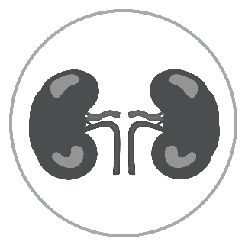

Know Your Condition—Polycythemia Vera (PV)
PV can also cause
more serious health problems because of thickening of the blood and excess blood cell production. Signs your healthcare team may look for include
An enlarged liver
An enlarged spleen
Stomach ulcers, gout, or kidney stones
Progression to leukemia
Mayo Clinic. Disease and Conditions: Polycythemia Vera. http://www.mayoclinic.com/health/polycythemia-vera/DS00919. Mayo Clinic web site. Accessed April 16, 2015.

Slide 33
Know Your Condition—Polycythemia Vera (PV)
Fatigue
Itching (pruritus)
Difficulty sleeping
Day or night sweats
Headaches or dizziness/vertigo
Numbness in hands and feet
Bruising
Hypertension
Facial flushing
Problems with concentration
Muscle aches
Abdominal pain/discomfort
Depression/Sad mood
Shortness of breath
Filling up quickly (early satiety)
Cough
Bone pain
Inactivity
Double or blurred vision
Pain under the left ribs
Fever (>100ºF)
In PV, symptoms you should look for include^{1,2}
1. Mesa R, Miller C, Thyne M, et al. BMC Cancer. 2016;16:167. 2. Scherber R, Dueck A, Johansson P, et al. Blood. 2011;118(2):401-408.

Slide 34
Know Your Condition—Polycythemia Vera (PV)
Common PV symptoms²
Tiredness or fatigue
Itching, especially after a warm shower
Sweating (at night or during the day)
Any other symptoms
Symptoms related to enlarged spleen in PV^{1,2}
Pain or discomfort under your left ribs
Feeling full when you haven’t eaten or have eaten very little
Other considerations
Frequency, time commitment and challenges you may have managing your PV¹
  Finding a phlebotomy center
  Time commitment related to having a phlebotomy
Be sure to tell your healthcare team if you experience
If you have answered YES to any of these questions, it is important to talk to your healthcare professional about your PV.
1. Leukemia & Lymphoma Society. Myelofibrosis Facts. Leukemia & Lymphoma Society web site. http://www.lls.org/content/nationalcontent/resourcecenter/freeeducationmaterials/mpd/pdf/idiopathicmyelofibrosis.pdf. Revised April 2012. Accessed March 11, 2015. 2. Mayo Clinic. Disease and Conditions: Polycythemia Vera. http://www.mayoclinic.com/health/polycythemia-vera/DS00919. Accessed April 16, 2015.

Slide 35
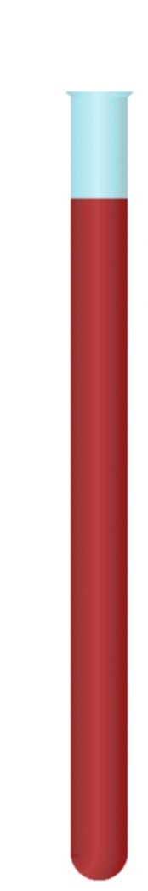
About Phlebotomy
A phlebotomy is a procedure to remove blood; it is typically done to decrease red blood cell (RBC) counts¹
To determine whether you need a phlebotomy, you will have your blood tested and separated into red blood cells, white blood cells, and plasma; this process is called centrifugation²
Centrifugation
Blood Sample
Normal Blood
Iron Deficient Anemia*
Anemia
Polycythemia Vera
*Chronic myeloid leukemia (CML).
1. Mayo Clinic. Polycythemia Vera: Treatments and Drugs. Mayo Clinic web site. http://www.mayoclinic.org/diseases-conditions/polycythemia-vera/basics/treatment/con-20031013. Accessed December 29, 2015. 2. Dean L. Blood Groups and Red Cell Antigens. Bethesda, MD: National Center for Biotechnology Information (US); 2005.

Slide 36
What About Red Blood Cells?
Phlebotomy is a procedure utilized to lower hemoglobin and hematocrit
Hematocrit is the proportion of your total blood volume made of red blood cells
Too many red blood cells can slow blood flow rate and increase the likelihood of thrombosis
Relative Viscosity
10 20 30 40 50 60 70 80 90
Hematocrit, %
MPN Research Foundation. Polycythemia Vera: Available Treatments. http://www.mpnresearchfoundation.org/Polycythemia-Vera-28PV-29#Available_Treatments. Accessed December 21, 2015.

Slide 37
Know Your Condition—Polycythemia Vera (PV)
Your healthcare team may discuss
Their goals for managing your condition
How your condition will be monitored
Overall treatment strategy
Factors that suggest a change in therapy is needed

Slide 38
Know Your Condition—
Essential Thrombocythemia (ET)
Description
Possible consequences
In ET, the body makes too many platelets
Patient Characteristics:
More common in females than males
Occurs most frequently after age 50
Formation of clots, potentially leading to heart attack
or stroke
What happens
Too many platelets can clump together in the blood, becoming difficult to flow through the body
Extra platelets can cause clots to form and increase the risk for serious problems
Essential thrombocythemia—
  throm-boe-sigh-THEE-me-uh
1. Mayo Clinic. Disease and Conditions: Essential Thrombocythemia. Mayo Clinic web site. http://www.mayoclinic.com/health/thrombocythemia/DS01087. Accessed April 16, 2015.
2. National Organization for Rare Disorders. Essential Thrombocythemia. National Organization for Rare Disorders web site. http://rarediseases.org/rare-diseases/essential-thrombocythemia/. Updated May 15, 2014. Accessed December 28, 2015.

Slide 39

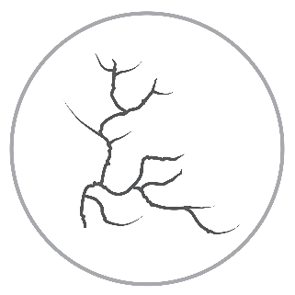

Know Your Condition—Essential Thrombocythemia (ET)
Though rare,
ET can lead to
more serious complications^{1,2}
Bruising, bleeding from the mouth or gums, bloody stools
Blood clots that lead to a stroke
Microvascular clots
Heart attack
Progression to leukemia
1. Mayo Clinic. Disease and Conditions: Essential Thrombocythemia. http://www.mayoclinic.com/health/thrombocythemia/DS01087. Mayo Clinic web site. Accessed April 16, 2015. 2. Keng M, Advani A, Theil K. Myeloproliferative Neoplasm. Cleveland Clinic web site. http://www.clevelandclinicmeded.com/medicalpubs/diseasemanagement/hematology-oncology/chronic-myeloproliferative-disorders/. Accessed September 30, 2015.

Slide 40
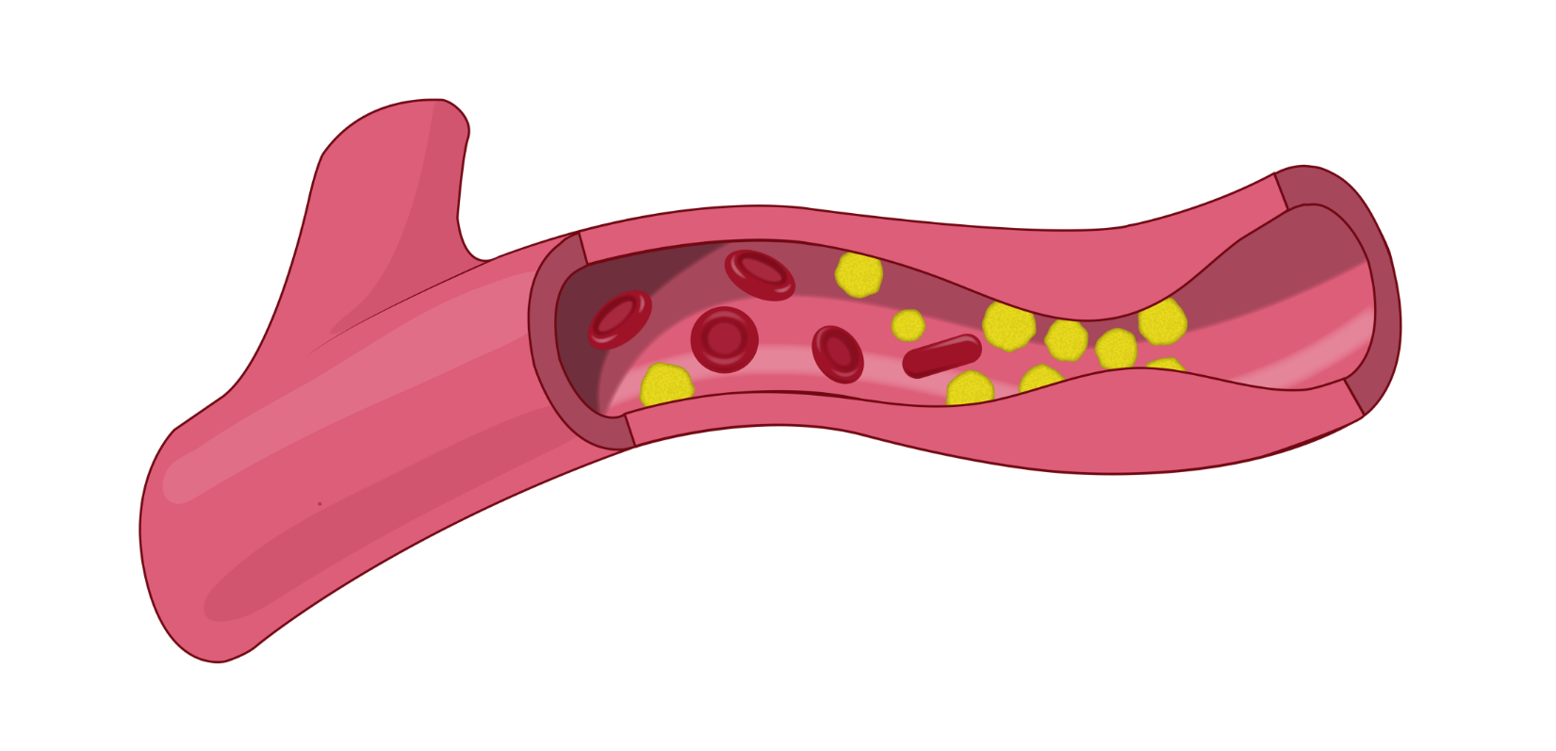
Potential Complications of Essential Thrombocythemia
Erythrocytes
Vessel Wall
Flow
Platelet Aggregates
Swollen
Endothelial Cells
Flow
Microvascular clots are blood clots that occur in the tiniest blood vessels of the body
These may manifest as a stroke when in the head or a heart attack when in the heart
Can lead to ulcers, gangrene in the fingers and toes, blue/purple skin, or painful dilation
ET also has other vascular complications
Ortel T. What Is Micro-Clotting? The APS Foundation of America. http://www.apsfa.org/docs/APSFAVol4Winter2007.pdf. Accessed December 29, 2015.

Slide 41
Know Your Condition—
Essential Thrombocythemia (ET)
Fatigue
Bruising
Numbness in hands and feet
Difficulty sleeping
Headaches
Dizziness/Vertigo
Night sweats
Depression/Sad mood
Problems with concentration
Itching (pruritus)
Abdominal pain/discomfort
Hypertension
Muscle aches
Bone pain
Weakness
Vision changes
Filling up quickly (early satiety)
Cough
Nosebleeds
Redness/Throbbing in hands/feet
Unintentional weight loss
In ET, symptoms you should look for include^{1,2}
1. Mesa R, Miller C, Thyne M, et al. BMC Cancer. 2016;16:167. 2. Scherber R, Dueck A, Johansson P, et al. Blood. 2011;118(2):401-408.

Slide 42
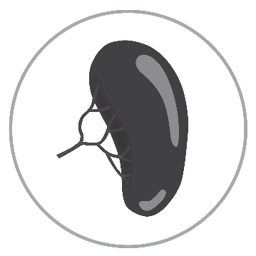

Know Your Condition—Myelofibrosis (MF)
Description
Possible consequences
In MF, abnormal blood cell production leads to bone marrow being replaced by fibrous (scar) tissue, which causes fewer healthy blood cells to be made
Patient Characteristics:
Enlarged spleen, bleeding, and anemia
Most commonly diagnosed in patients over 50
Observed at a similar rate in males and females
What happens
When bone marrow cannot make enough healthy blood cells, the spleen begins to make them, causing the spleen to enlarge (splenomegaly)
Abnormal production of all 3 main types of blood cells can occur
Myelofibrosis—
my-ah-lo-fye-BRO-sis
1. Leukemia & Lymphoma Society. Essential Thrombocythemia Facts. Leukemia & Lymphoma Society web site. http://www.lls.org/content/nationalcontent/resourcecenter/freeeducationmaterials/mpd/pdf/essentialprimarythrombocythemia.pdf. Revised June 2012. Accessed March 11, 2015. 2. Mayo Clinic. Disease and Conditions: Myelofibrosis. Mayo Clinic web site. http://www.mayoclinic.com/health/myelofibrosis/DS00886. Accessed April 16, 2015.

Slide 43


Know Your Condition—Myelofibrosis (MF)
MF can also
cause more serious complications.
Signs your healthcare team may look
for include
Gout
Serious bleeding, portal hypertension (elevated pressure in the vein leading to the liver)
Infections
Progression to leukemia
Leukemia & Lymphoma Society. Myelofibrosis Facts. Leukemia & Lymphoma Society web site. http://www.lls.org/content/nationalcontent/resourcecenter/freeeducationmaterials/mpd/pdf/idiopathicmyelofibrosis.pdf. Revised April 2012. Accessed March 11, 2015.

Slide 44
Know Your Condition—Myelofibrosis (MF)
Fatigue
Abdominal pain/discomfort
Night sweats
Difficulty sleeping
Itching (pruritus)
Filling up quickly (early satiety)
Bone pain
Headaches or dizziness/vertigo
Unintentional weight loss
Depression/Sad mood
Inactivity
Cough
Weakness
Problems with concentration
Pain under the left ribs
Fever (>100ºF)
In MF, symptoms you should look for include^{1,2}
1. Mesa R, Miller C, Thyne M, et al. BMC Cancer. 2016;16:167. 2. Scherber R, Dueck A, Johansson P, et al. Blood. 2011;118(2):401-408.

Slide 45

Know Your Condition
For chronic conditions like MPNs,
it is important to
Discuss your condition with your physician
Know the importance of blood tests
Keep regular visits with your
healthcare team
Maintain a healthy lifestyle
Pay attention to your symptoms
Get help and support when you
need it

Slide 46
Monitor Your MPN With a Symptom Tracker
10 MPN symptoms to watch for
Fatigue (tiredness)
Filling up quickly when you eat
(early satiety)
Abdominal discomfort
Inactivity
Problems with concentration
Night sweats
Itching
Bone pain
Fever
Recent, unintentional weight loss
You can download additional copies of the
MPN10 Symptom Assessment Form online at http://jco.ascopubs.org/content/suppl/2012/10/15/JCO.2012.42.3863.DC1/data_supplement_JCO.2012.42.3863.pdf.
Scherber R, Dueck A, Johansson P, et al. Blood. 2011;118(2):401-408.

Slide 47
Take an Active Role in
Managing Your Condition

Slide 48
Know When to Talk With Your Healthcare Team
Your individual journey and responsibilities as a patient
with an MPN:
  Understand your unique condition
  Know the ways to manage your condition
  Remain knowledgeable about MPNs
  Continue having regular discussions with your healthcare team

Slide 49

Potential Management Goal Considerations
Enhancement of Overall Health
Reduction in Spleen Size
Symptom Improvement
Prevention of Vascular/Thrombotic Events
Healthy Blood
Counts
Improvement in Quality of Life and Productivity

Slide 50
Management Depends on Type and Status of Your MPNs
Therapies aim to reduce signs/symptoms and risk of complications²
Stimulate or suppress production of certain blood cell types
Reduce risk of clotting (thrombosis) in ET and PV
Reduce disease-related symptoms
Reduce pain associated with splenomegaly and bone pain
Reduce the risk of bleeding/ number of bleeding episodes
Some types of therapies used^{1,2}
Transfusion therapy
Platelet apheresis
Phlebotomy
Surgery
Radiation
Stem cell transplant
Drug therapies
    Chemotherapy
    Biologic therapy
    Targeted therapy
    Other drug therapies,
    including low-dose
    aspirin
Watchful waiting—closely monitor without therapy unless
signs or
symptoms change¹
1. Seattle Cancer Care Alliance. MPN Treatment Options. http://www.seattlecca.org/diseases/myeloproliferative-neoplasms-treatment.cfm. Accessed December 28, 3015. 2. National Cancer Institute. Chronic Myeloproliferative Neoplasms Treatment (PDQ®) Patient Version. National Cancer Institute web site. http://www.cancer.gov/cancertopics/pdq/treatment/myeloproliferative/Patient. Updated November 6, 2015. Accessed December 28, 2015.

Slide 51

Clinical Trials
Goals of clinical trials¹⁻³
  Advance research and
  understanding of MPNs
  May seek FDA approval for new therapies
Risk profile may not be fully understood⁴
  FDA approval is not guaranteed
  Treatment may be ineffective
Research areas for future therapies¹⁻³
Combination therapies
New approaches to classification, diagnosis, and therapy
Regulation of gene expression
1. National Organization for Rare Disorders. Polycythemia Vera. National Organization for Rare Disorders web site. http://rarediseases.org/rare-diseases/polycythemia-vera/. Updated May 8, 2013. Accessed December 28, 2015. 2. National Organization for Rare Disorders. Essential Thrombocythemia. National Organization for Rare Disorders web site. http://rarediseases.org/rare-diseases/essential-thrombocythemia/. Updated May 15, 2014. Accessed December 28, 2015. 3. National Organization for Rare Disorders. Primary Myelofibrosis. National Organization for Rare Disorders web site. http://rarediseases.org/rare-diseases/primary-myelofibrosis/. Updated May 5, 2013. Accessed December 28, 2015. 4. National Institute of Health – US National Library of Medicine. Benefits and Risks of Clinical Trials. https://www.nlm.nih.gov/services/ctbenefits.html. Update October 11, 2006. Accessed January 4, 2015.

Slide 52
Remain Involved In and Understand Your Management Plan
Know your
management goals
Know your blood
count targets
Know your
management plan
Know how often to schedule office visits
and tests
Know what symptoms and problems to watch for
Prepare for
office visits
Track your care
Keep your
healthcare
team updated
Discuss with your healthcare team
Partner with Your Healthcare Team
Understand Your Management Plan

Slide 53
Finding the Right Healthcare Team
Recommendations from the American Cancer Society
Questions to ask yourself after meeting with a healthcare professional
How comfortable did you feel talking with him/her?
Did he/she give you a chance to ask questions?
Did he/she seem comfortable answering your questions?
Did he/she talk to you in a way that you could understand?
Do you feel he/she listened to you and respected you?
Did he/she talk about short- and long-term management goals?
Do you feel he/she spent enough time with you?
American Cancer Society. Choosing a Doctor and a Hospital. American Cancer Society web site. http://www.cancer.org/treatment/findingandpayingfortreatment/choosingyourtreatmentteam/choosing-a-doctor-and-a-hospital. Accessed March 11, 2015.

Slide 54
Talking With Your Healthcare Team
What kinds of treatments are available to me, and what do you recommend?
What will this treatment do? (Is it to control my MF or to relieve my symptoms?)
What are the risks and benefits of this treatment?
What side effects might I experience due to treatment, and how can we manage them?
How long will this treatment last, and how do I take it?
How will you monitor how I do on this treatment and how well it is working?
If insurance does not cover the cost of this treatment, where can I go for help?
Are there clinical trials that might be appropriate for me? Where can I go to learn about them?
What about alternative treatments? Can you recommend any diet, exercise, or vitamins that would help me?

Slide 55
Be Your Own Advocate

Slide 56

Give Yourself the Support You Need
Give yourself support in
ways that work for you
Share your thoughts and feelings with family and friends
Find support in your community and/or online
Talk to your healthcare team; they can recommend trained counselors

Slide 57

Always Share What’s on Your Mind
For chronic conditions like MPNs,
it is important to
Maintain relationships with your healthcare team
Stay involved in your management plan
Reevaluate changes in how you feel
Ask questions about things you have learned

Slide 58

Find Enjoyment Each Day
Write a “to enjoy” list so each day
is fulfilling
  Music, food, walks, parks
When possible, keep doing your
favorite activities
  Try new ones, too
Set dates and plan events to look
forward to

Slide 59
Other Resources to Be Aware Of

Slide 60
Nonprofit Websites
Nonprofit, or 501(c)(3), organizations are approved by the IRS as tax-exempt, charitable organizations
  MPN Research Foundation – Designed to stimulate original research in pursuit of new treatments, and eventually a cure, for myeloproliferative neoplasms (MPNs).
  www.mpnresearchfoundation.org
  MPN Education Foundation – Mission goals include providing information, education, and support; patient and physician conferences; doctor-patient sharing; doctor/researcher networking; facilitating patient participation/accrual in clinical studies and surveys
  www.mpninfo.org
  Other nonprofit groups that support MPNs
      Cancer Care – www.cancercare.org
      Cancer Support Community – www.cancercupportcommunity.org
      LLS – www.lls.org
      NORD – www.rarediseases.org

Slide 61
Organization Websites
Organization websites include information put out by larger clinics, hospitals, and pharmaceutical companies
Sponsored Websites:
  MPN Advocacy & Education International – www.mpnadvocacy.com
  Voices of MPN – www.voicesofmpn.com
  CancerConnect – news.cancerconnect.com
  Patient Power – http://www.patientpower.info/
Medical Community Websites:
  Mayo Clinic – http://www.mayoclinic.org/
  WebMD – http://www.webmd.com/

Slide 62
Financial Support
Patient assistance programs are available for eligible patients with chronic and/or rare diseases
  Patient Access Network Foundation – Provides qualified individuals with funding for paying a certain type of out-of-pocket medical costs. Funding is offered for those qualified patients who are unable to afford their prescription medications. www.panfoundation.org
  Good Days – Their mission is to ensure that no one has to choose between getting the medication they need and affording the necessities of everyday living. www.gooddaysfromcdf.org
  NORD – Provides assistance programs to help patients obtain life-saving or life-sustaining medication they could not otherwise afford. Provides medication, financial assistance, diagnostic testing, and travel assistance for clinical trials or consultation with disease specialists for eligible patients. www.raredisease.org
  NeedyMeds – A nonprofit organization that maintains an extensive database of information about patient assistance programs, state assistance, drug discount programs, and free or low-cost medical care. www.needymeds.org

Slide 63
Thank You
UPM-1060f

